Slide 1
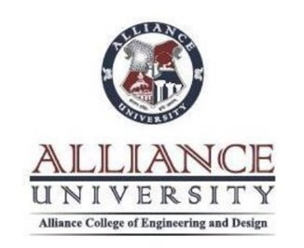
COMMUNICATION AND SOFT SKILLS
BY-CHANDANA MN(CSE-087)
ASSIGNED BY- PROF.NAYANATHARA

Slide 2
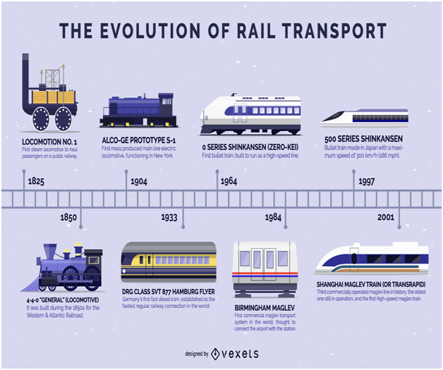

Slide 3
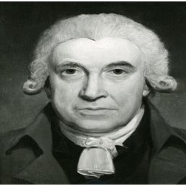
James Watt

Slide 4
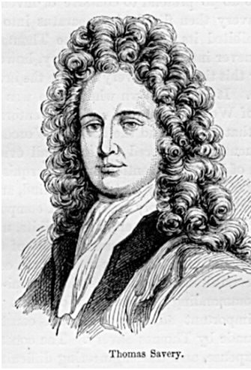
Thomas Savery

Slide 5
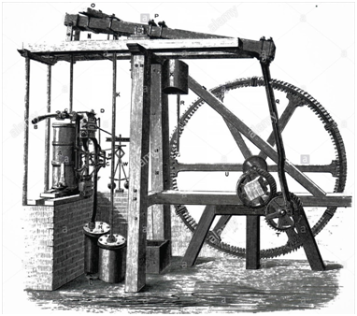
Watt steam engine

Slide 6
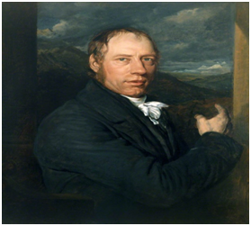
Richard Trevithick

Slide 7
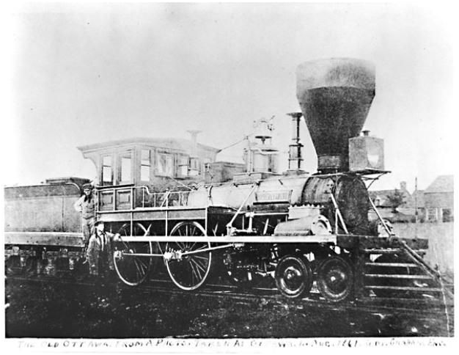
First working railway
The first full-scale working railway steam locomotive was built in the United Kingdom in 1804 by Richard Trevithick, a British engineer

Slide 8
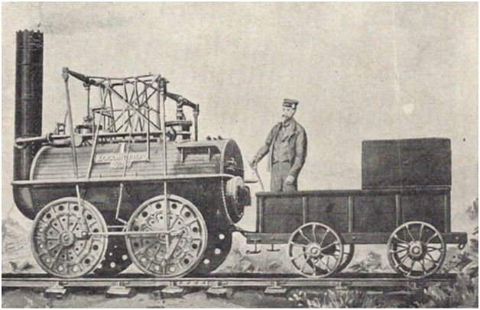
AMERICA'S FIRST TRAIN

Slide 9
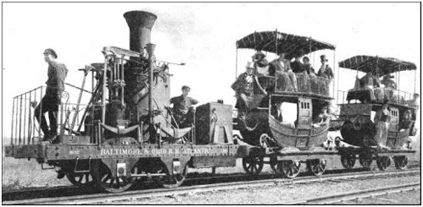
World's First Passenger Train
On September 27, 1825, Locomotion No. 1 became the world's first steam locomotive to carry passengers on a public line, in North East England.

Slide 10
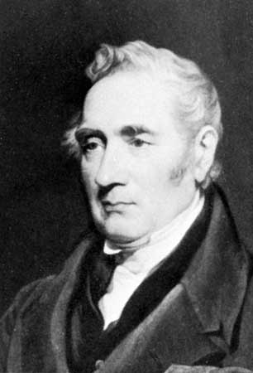
George Stephenson
Locomotion No. 1 was built by George Stephenson
George Stephenson drove the first train. The engine was called Active (later renamed Locomotion). It pulled a train with 450 passengers at a speed of 15 miles an hour.

Slide 11
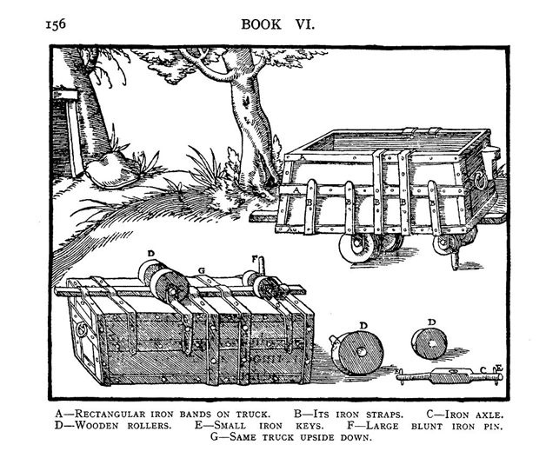
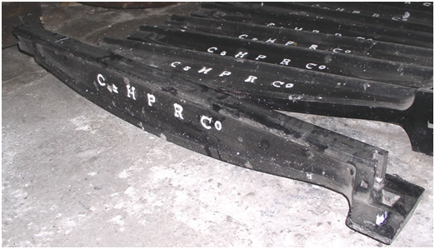
RAILS
WOOD RAILS
METAL RAILS

Slide 12
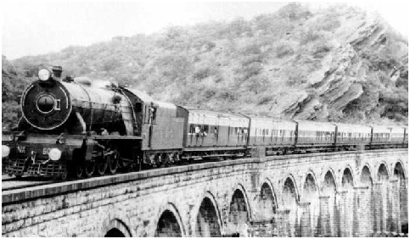
The history of Indian Railways
The history of Indian Railways dates back to over 160 years ago. On 16th April 1853, the first passenger train ran between Bori Bunder (Bombay) and Thane, a distance of 34 km. It was operated by three locomotives, named Sahib, Sultan and Sindh, and had thirteen carriages.

Slide 13
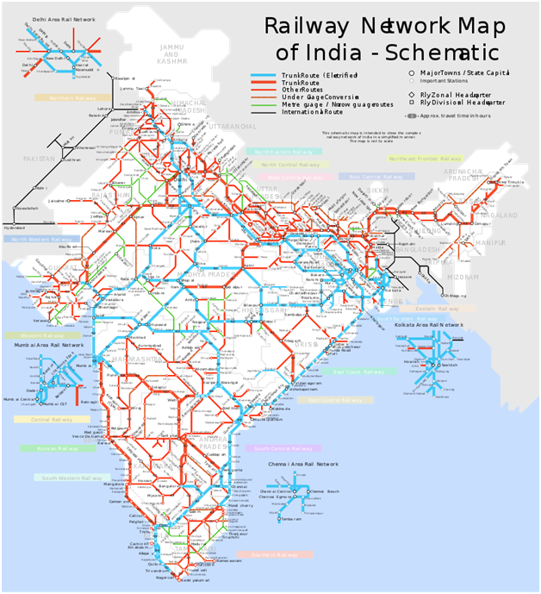
Vast Railway Network in India
The Indian Railways’ track is spread across a massive 115,000 km, making it the largest rail network in Asia and the world’s second largest network operated under a single management. The entire track covers a route length of 67,368 km. The full track length of Indian Railways can circle the equator 1.5 times.

Slide 14
Kolkata Metro
The first rapid transit system in India is the Kolkata Metro, which started operations in 1984.
Delhi Metro
The Delhi Metro has the largest network in the entire country.

Slide 15
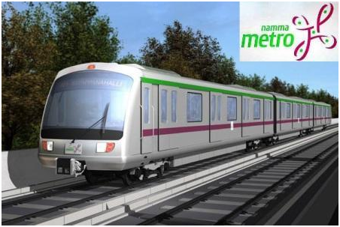
BANGLORE Metro
Banglore is known as Namma Metro
Started-October 20, 2011

Slide 16
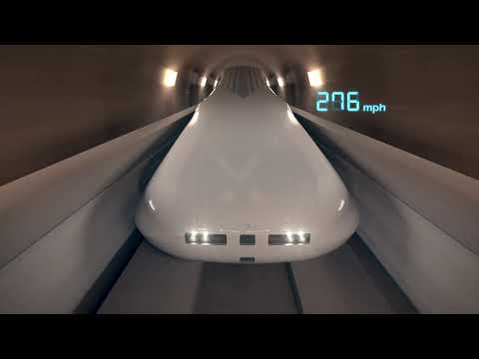

Slide 17


